Slide 1

Financial Performance Management RBP020L062S
Week 2
Ratio Analysis: an application

Slide 2
Learning outcomes
At the end of this session you should be able to:
Evaluate the financial performance of a real company
using ratio analysis.
Understand the importance of ratio analysis for internal and external stakeholders.
Appreciate the need to balance financial and non-financial
measures to evaluate the performance of an organization.

Slide 3

Recap on
Financial Statement Analysis
Ratio Analysis An application
to Coca-Cola Company

Slide 4



Financial Statements
FINANCIAL STATEMENTS
BALANCE SHEET
INCOME STATEMENT
CASH FLOW STAT.
Financial position at a specific moment of time
Revenues and expenses
for a period of time
Cash inflows and cash outflows for a period of time
+ NOTES TO THE ACCOUNT
+ STATEMENT OF CHANGES IN SHAREHOLDERS’ EQUITY

Slide 5

The Balance Sheet
The balance sheet, or statement of financial position:
lists the firm’s assets and liabilities
provides a snapshot of the firm’s financial position at a given point in time
The Balance Sheet Equation:
Assets = Liabilities + Shareholders’ Equity
Assets: Cash, inventory, property, plant, equipment, and other investments
Liabilities: Obligations to creditors
Equity: assets minus liabilities, firm’s net worth

Slide 6
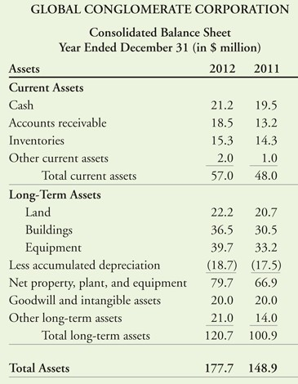
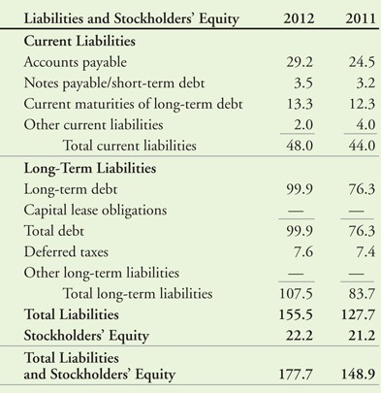
The Balance Sheet
The Balance Sheet Equation: Assets = Liabilities + Equity

Slide 7




The Income Statement
The income statement, or statement of financial performance, lists the firm’s revenues and expenses over a period of time.
Shows firm’s net income or earnings.
If income is greater than expenditure for the year then the company has made a profit.
If expenditure exceeds income then a loss has been made.

Slide 8
The Income Statement
Total Sales/Revenues
- Cost of Sales
= GROSS PROFIT
- Operating Expenses
= OPERATING INCOME
+/- Other income/Other expenses
= EARNINGS BEFORE INTEREST AND TAXES (EBIT)
+/- Interest Income/Interest Expense
= PRE-TAX INCOME
- Taxes
= NET INCOME
The income statement shows a company’s performance over a period of time by subtracting expenses from revenues to obtain net income.

Slide 9
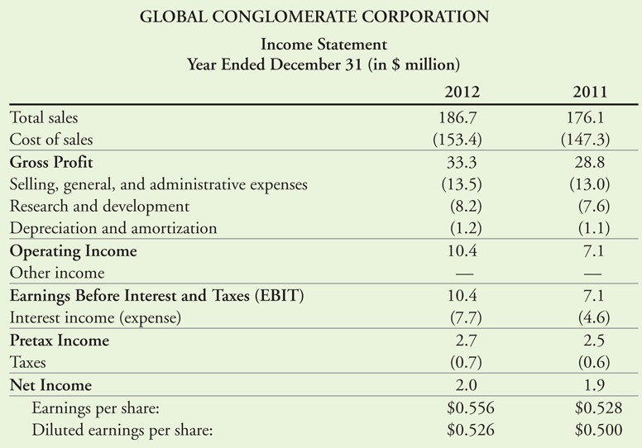
The Income Statement

Slide 10
The Statement of Cash Flows
Net Income typically does NOT equal the amount of cash the firm has earned.
Non-Cash Expenses: Depreciation and Amortization
Uses of Cash not on the Income Statement: Investment in Property, Plant, and Equipment
The statement of cash flows shows the cash received and paid by a company during its accounting period
Three Sections: Operating Activity, Investing Activity, Financing Activity

Slide 11
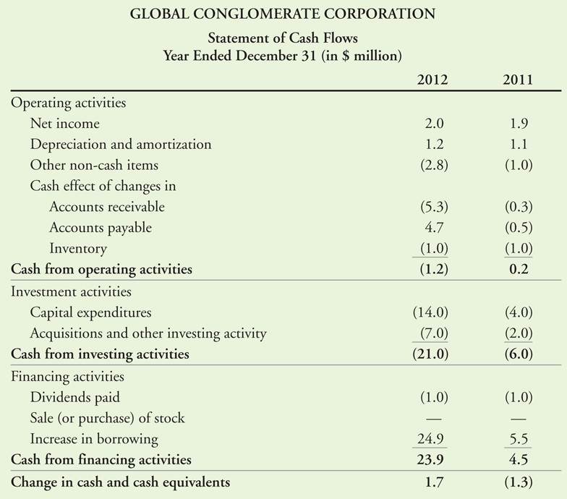
The Statement of Cash Flows

Slide 12
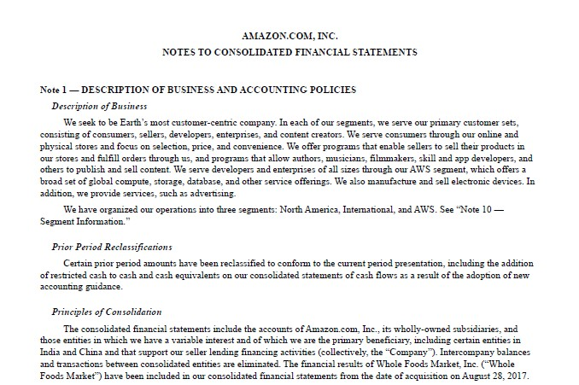
Read the Notes

Slide 13

Ratio Analysis

Slide 14
Financial ratio analysis
Performance is measured in 3 perspectives (3 Eff’s):
Efficiency: The economic use of scarce resource. Measure of efficiency takes the input to the process and access how economically they are used to produce a given output and tends to focus on cost.
Effectiveness: The production of the results or effect. The value of output produced from a given set of resources.
Efficacy: The production of result intended. The measure of efficacy access the degree to which inputs produced the result intended and thereby contributed to the true achievement of the enterprise.
Financial statements are used by investors to:
Compare the firm with itself.
Compare the firm to other similar firms.

Slide 15
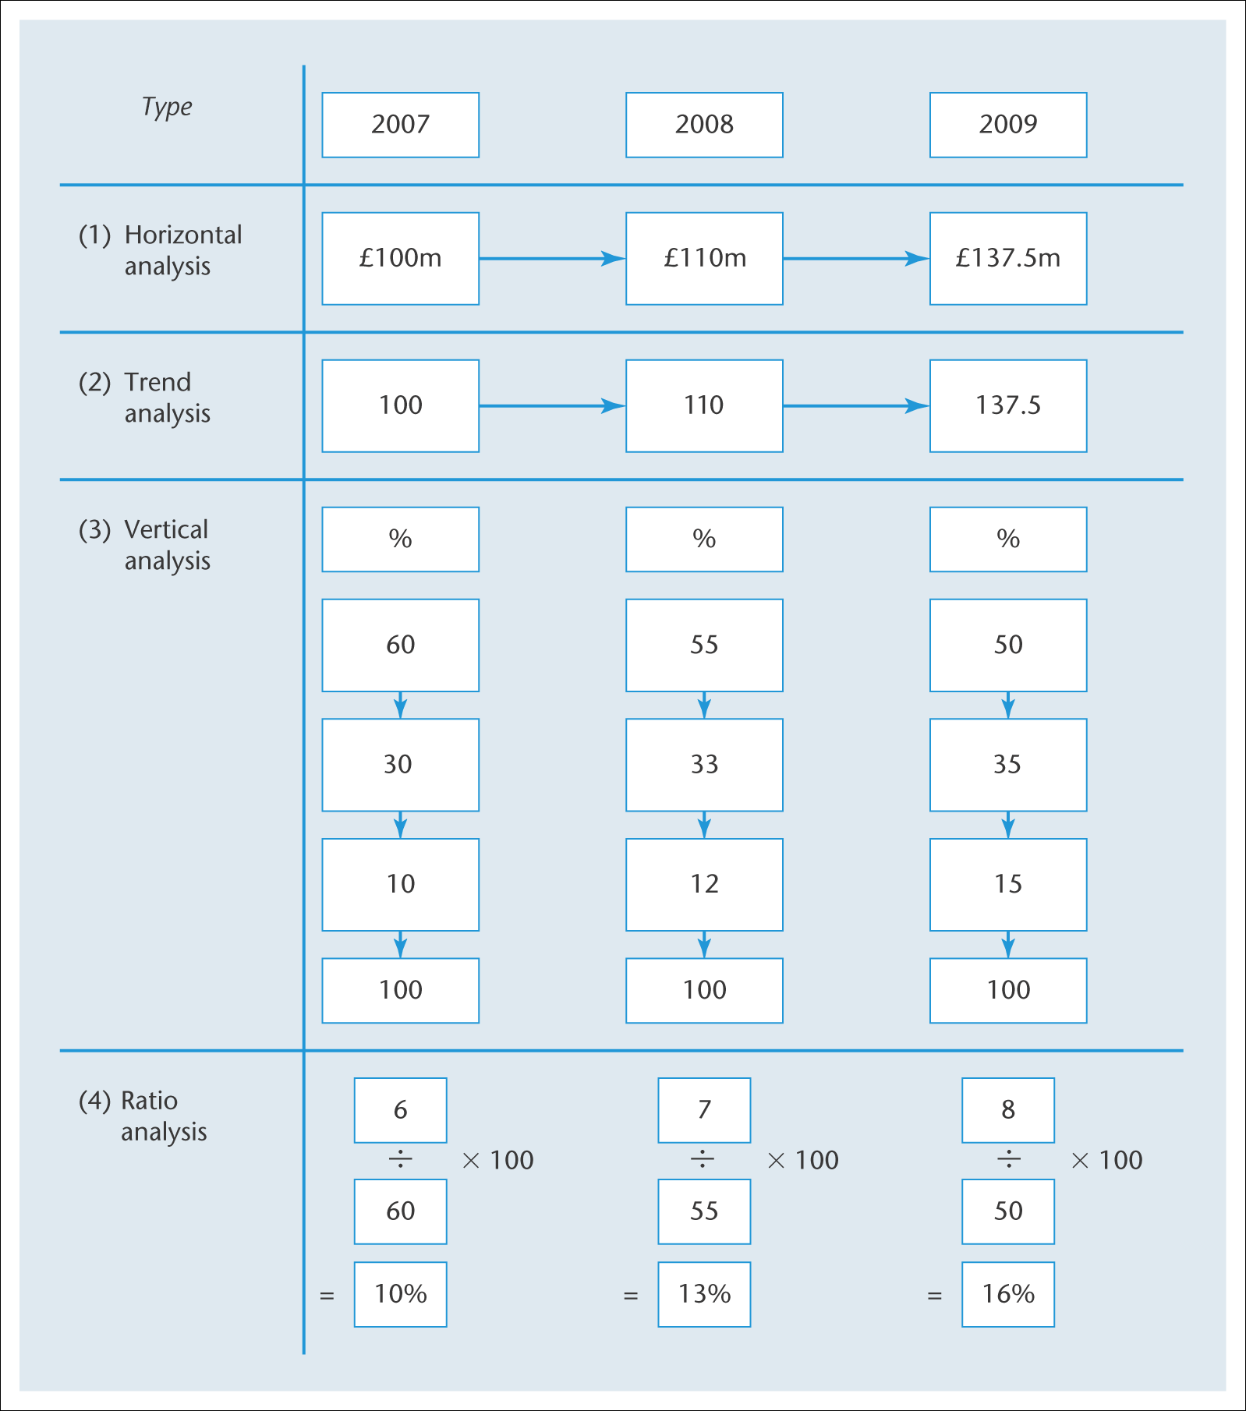
Interpreting Financial Statements: Main Analytical Techniques

Slide 16
Financial ratio analysis
LIQUIDITY RATIOS
Ratios designed to measure the ability of the firm to meet its short term
liabilities as they come due.
PROFITABILITY RATIOS
Ratios designed to measure the earning power of the firm.
LEVERAGE RATIOS (or Solvency/Capital Structure ratios)
Refer to the extend to which a firm employs debt capital to finance its operations.
WORKING CAPITAL RATIOS (or Asset Management Ratios)
Ratios designed to measure the relation between annual sales and investments in various classes of asset accounts.
VALUATION RATIOS
used (by current and potential investors) to evaluate the current share price of a publicly-held company's stock.

Slide 17
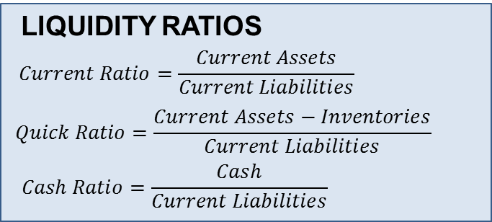
Can a business meet its current debt obligations with its current assets?
Working capital ratio (or Current ratio)
It measures whether the business can pay its short-term debt obligations
with its current assets.
Quick ratio (or acid test ratio)
It measures whether the firm can meet its short-term debt obligations without selling any inventory.
Cash ratio
It indicates the ability of the firm to pay off all its current liabilities without liquidating any other assets.
The figures are from the balance sheet.

Slide 18
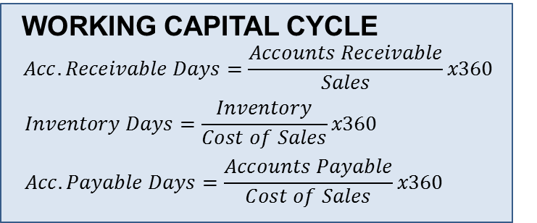
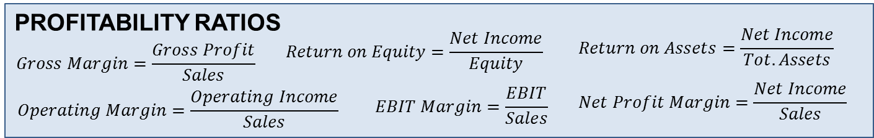
How many days it takes to convert working capital into revenues.
How efficiently the firm is using its assets to generate sales and maximise profit (i.e. efficiency ratios)
Cash operating cycle = Inventory days + Receivables days – Payables days
A company's ability to generate income relative to its revenue, operating costs, balance sheet assets, or shareholders' equity.

Slide 19
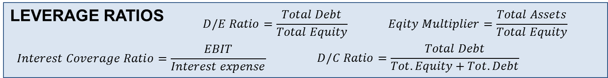
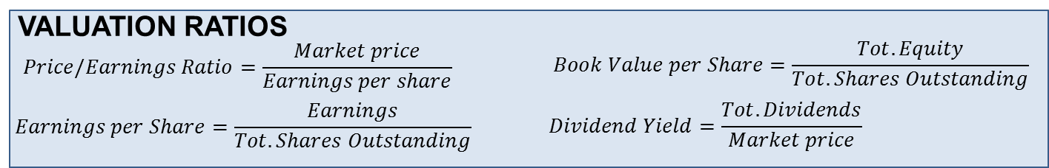
What is the financial position of a company and ability to meet
financial obligations (also called solvency ratios)
Evaluate the current share price of a publicly-held company's stock, particularly of interest by current and potential investors (also called market value ratios)

Slide 20




















Formula Snapshot
LIQUIDITY RATIOS
WORKING CAPITAL CYCLE
PROFITABILITY RATIOS
LEVERAGE RATIOS
VALUATION RATIOS

Slide 21



Performance Using Accounting ratios
Comparison of ratios
actual results with budget or forecast
this year with last year
with another company
with industry average
Context of the Business/Industry sector.
Purpose of review/interested parties: Investor, Customer, Provider of loan capital, Government
Focus on key relevant issues.

Slide 22
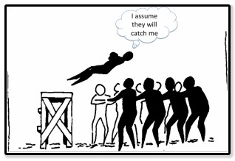


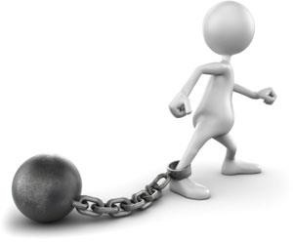
Ratio analysis
Assumptions
Accounting policies are consistent with previous year/budget/forecast.
Accounting policies are broadly similar with that used in the industry generally, e.g. methods of stock valuation, depreciation, etc..
Company aims to maximise profits.
Inflation, tax is considered constant
Limitations
Lack of detail in financial statements
Variations of Accounting policies
Asset values - Historic cost or revalued
Is Prudence built into figures?
Possible Management bias

Slide 23


Ratio analysis: exercise
Who We Are: The Coca-Cola Company

Slide 24
Ratio analysis: exercise
Download the annual report available on the company website. Identify the company’s Balance Sheet and Income Statement for the years 2016 and 2017.
Analyse the financial performance of the company using ratio analysis. Specifically, calculate liquidity ratios, profitability ratios, leverage ratios, working capital ratios, and valuation ratios.
Identify the closest competitor. Evaluate the financial performance of the company over time and with respect to the competitor.

Slide 25

https://www.coca-colacompany.com/

Slide 26
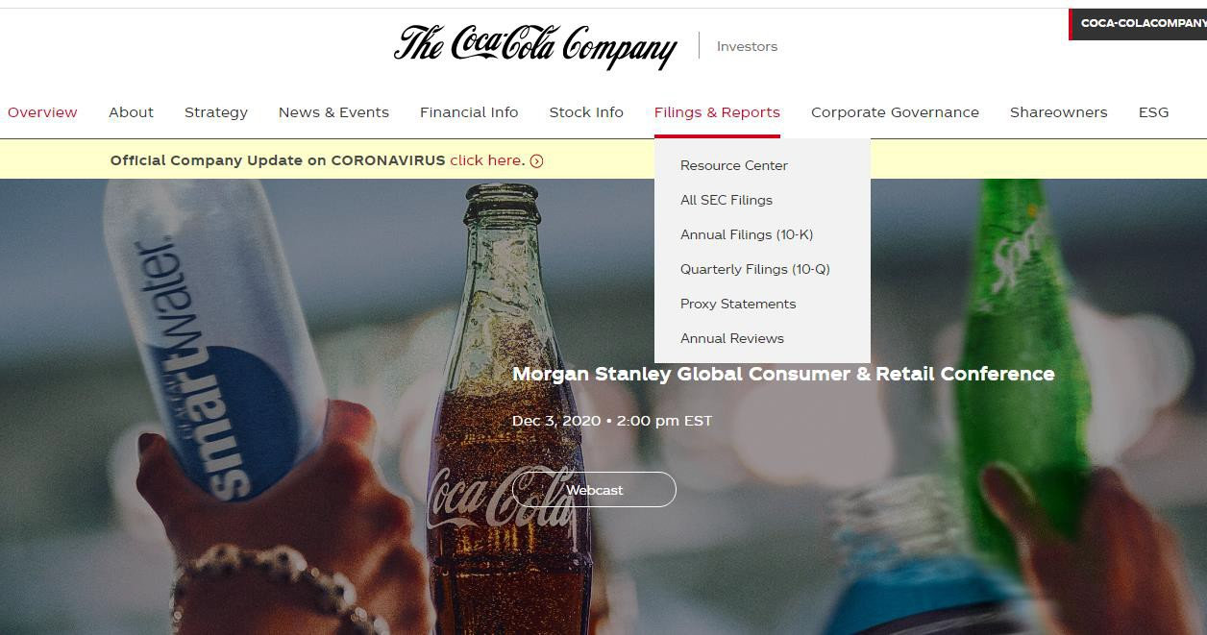
https://www.coca-colacompany.com/

Slide 27

Working towards the assignment
Extract from the assessment brief (read the full
document available on Moodle:
Select an international organisation (of your choice – company A)
Identify its closest competitor (company B)
Present the two organisations and the criteria used for the identification of the competitor.
Use ratio analysis technique to evaluate the financial performance of the two organizations (using the annual financial statements of the last two years)
“Ratio analysis template” provided on Moodle

Slide 28

Readings
Atrill, P. and McLaney, E. (2018). Management Accounting for Decision Makers. Pearson, 9th Edition, Chapter 1.
Berk, J. and DeMarzo, P. (2017). Corporate Finance. Pearson,
3rd edition, Chapter 2.
Go to Explore section on Moodle and to the Share & Apply seminar

